Slide 1

Dunnhumby Retail Store Analysis
Streamlining Performance through Strategy Reformation Analysis: A Supply Chain Analytics Perspective
Supply Chain Rangers LLC
Cornell University SC Johnson College of Business
Justin Bowser Daylyn Mosher Hassan Radwan Nisha Ramasubramonian Ben Wixson
Supply Chain Rangers LLC
01
Notes:
Daylyn

Slide 2
Agenda
Meet the Team
Executive Summary
Data Overview
Supply Chain Optimization
Coupon Optimization & Customer Loyalty Program
Store Optimization Model & Store Segmentation
Demand Forecasting
Closing Statement and Recommendation
Supply Chain Rangers LLC
02
Notes:
Daylyn

Slide 3










Supply Chain Rangers
Meet the Team
Justin Bowser
Daylyn Mosher
Hassan Radwan
Nisha Ramasubramonian
Ben Wixson
Supply Chain Rangers LLC
03
Notes:
Daylyn

Slide 4
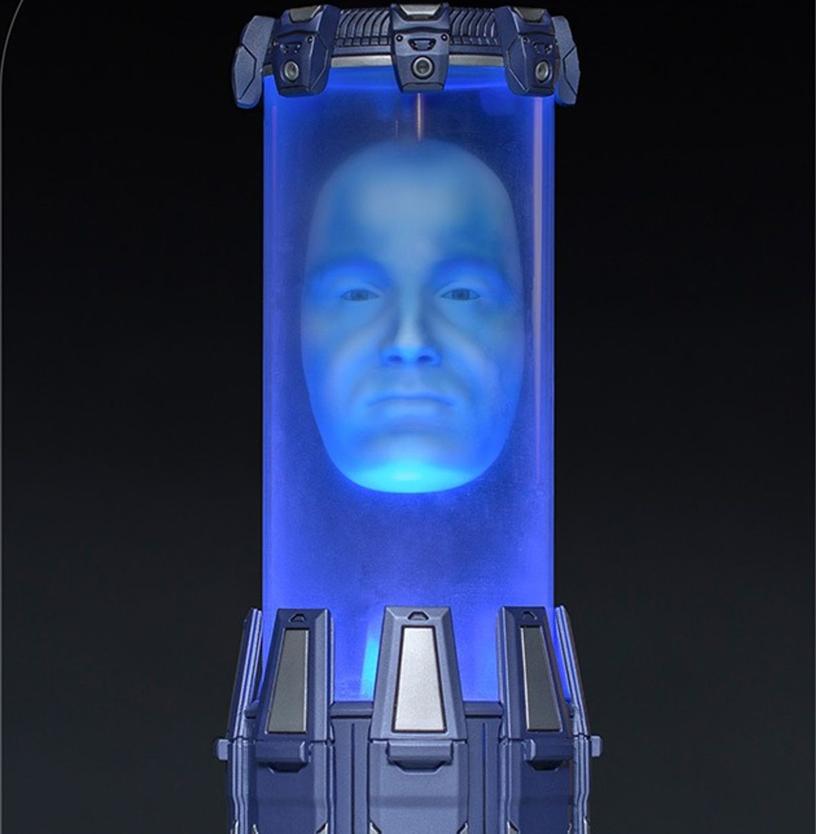

Zordon
Meet the Team
Gad has spent the last 15 years helping businesses grow using data.
Leading marketing science & analytics at Chewy since 2020.
Before Chewy, Gad was Director of marketing science at Facebook/Meta. Prior to Meta, Gad has been mostly in the start-up and scale-up scene, including Google. Before joining the tech world, he’s also been a consultant at Bain & Company.
Bachelor/Masters degree in Industrial Engineering and an MBA from Cornell.
Gad Alon
Supply Chain Rangers LLC
04
Notes:
Daylyn
Gad has spent the last 15 years helping businesses grow, by operating at the intersection of data/analytics, marketing growth, and product management.
Since 2020 he is leading marketing science & analytics at Chewy, one of the fastest-growing e-commerce destinations in the US. Chewy went public in 2019 and grew to become a Fortune 500 in mid-2021.
Before Chewy, Gad was Director of marketing science at Facebook/Meta, managing a team that owns a set of Ads Measurement Products and influenced ~$5B in client ad spends on Facebook and Instagram of top tier Fintech, Ecommerce, and Gaming clients (e.g. SoFi, Robinhood, Peloton, StitchFix, Wish)
.
Prior to Meta, Gad has been mostly in the start-up and scale-up scene, including Google. Before joining the tech world, he's been a consultant at Bain & Company.
Gad holds a Bachelor/Masters degree in Industrial Engineering and an MBA from Cornell.

Slide 5
Up Next
Meet the Team
Executive Summary
Data Overview
Supply Chain Optimization
Coupon Optimization & Customer Loyalty Program
Store Optimization Model & Store Segmentation
Demand Forecasting
Closing Statement and Recommendation
Supply Chain Rangers LLC
05

Slide 6




A Data Science Firm Helping Retailers
Business Context
Dunnhumby is a U.K.-based company headquartered in London, England, UK. Focusing on retail and brand data science, it applies insights from more than 660 million shoppers across the globe.
Business Problem: A major retail chain has a need to optimize supply chain and improve demand forecasting to maximize revenue.
Objective: Using data science, we aim to analyze the dataset to eliminate low-performing products, optimize inventory, improve demand forecasts and propose the best segment as a business model.
Supply Chain Rangers LLC
06
Notes:
Dunnhumby is based in London, England, UK and they focus on retail and brand data science. They apply insights from more than 660 million shoppers across the globe. Dunnhumby helps retailers and brands perfect the science of shopping.
The business problem:
A major retail chain has a need to optimize supply chain and improve demand forecasting to maximize revenue. In this scenario you can think of us as consultants making a recommendation to Dunhumby on how to tackle this customer of theirs.
Our objective is through the use of data science, we’ll analyze the dataset to eliminate low-performing products, optimize inventory, improve demand forecasts and propose the best segment as a business model.

Slide 7
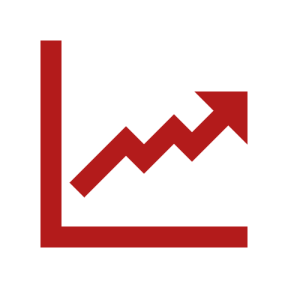




The Roadmap to Success
Executive Summary
Coupon Optimization
Customer Loyalty Program
By offering various coupon campaigns we were able to condense which campaigns were successful (26, 20, 8) and which ones to terminate as it was eating up costs (20,6,15) and was not successful in acquiring new customers. The use of coupons as brought in 19% of new customers.
The customer loyalty program is a sales driver increasing the number of sales per basket and is mostly used by those in the income levels of 35k and 74k annually. The customer loyalty programs are effective when goods are effectively stocked for these income brackets.
Product Optimization
Store Segments
Demand Forecasting
Product optimization will utilize product families and groups to identify underperforming products that can be eliminated. This can process can be improved by providing inventory and store location data. By targeting low performing products in one of the store categories, soft drinks, we were able to reduce this category by 16%.
The store segments model is a diagnostic lens that captures the best business model using performance analysis resulting in profit maximization and cost cutting insights. There are 60 stores segmented into four groups: low, mid, high, and very high performance segments for 2 periods 2020-2021.
Exponential Smoothing provided the best results as measured by root square mean error. Though the results are very promising, with further data and fine tuning of hyperparameters model accuracy will likely improve even further. Having more accurate demand forecasting models will further improve product optimization.
Supply Chain Rangers LLC
07
Notes:
Ben: Welcome to our roadmap to success, where we highlight key strategies that will drive our growth and market leadership. Let's delve into the core elements that form the foundation of our success:
Coupon Optimization: We identify which coupon campaigns have proven successful. By eliminating less effective campaigns, we plan to reduced costs and successfully acquired 19% of new customers through coupon promotions.
Customer Loyalty Program: The customer loyalty program has emerged as a powerful sales driver, particularly popular among customers with annual incomes between 35k and 74k. This also creates opportunity.
Product Optimization: Utilizing product families and groups, we are streamlining our product portfolio by identifying underperforming products for elimination.
Store Segments: Our diagnostic store segments model categorizes our stores sales performance segments for 2020-2021. This analysis empowers us with profit maximization and cost-cutting insights, ensuring efficiency across our retail network.
Demand Forecasting: By leveraging data-driven insights, we identify trends and align strategic objectives, determining which products are in demand, when, and under what conditions.

Slide 8
Up Next
Meet the Team
Executive Summary
Data Overview
Supply Chain Optimization
Coupon Optimization & Customer Loyalty Program
Store Optimization Model & Store Segmentation
Demand Forecasting
Closing Statement and Recommendation
Supply Chain Rangers LLC
08

Slide 9
Dunnhumby Data Insights
Data Overview
Dataset Details:
Customers demographics
Campaigns and coupons
Stores and products
Sales and transactions
Data Transformation
Supply Chain Rangers LLC
09
Notes:
Slide 9: Dunhumby Data Insights
The Dunnhumby dataset presents approximately two years of transactional data across 582 stores and 92 thousand products.
This included data pertaining to customer household demographics, coupon and product campaign data, product data including manufacturer data, as well as transactional data.
The time period of the data spanned at max a total of 102 weeks.
An in-depth analysis revealed a significant number of stores with incomplete transaction records over the dataset's timeline. In fact, several stores only had one transaction during the entire 102-week period.
To ensure a consistent timeline, transaction data was filtered to include only those stores with a record spanning the full dataset period. The selection criteria were stores with a minimum week of data at 1 and a maximum week of data at 102.
Despite the potential for bias introduced by this filtering approach, it was deemed appropriate for the project's purpose: building a model for product optimization. This is based on the assumption that a consistent timeline across all stores is more important for accurate demand forecasting and subsequent product mix optimization. Then we can test the model on other stores and adjust it as needed to correct for the bias.

Slide 10
Up Next
Meet the Team
Executive Summary
Data Overview
Supply Chain Optimization
Coupon Optimization & Customer Loyalty Program
Store Optimization Model & Store Segmentation
Demand Forecasting
Closing Statement and Recommendation
Supply Chain Rangers LLC
10

Slide 11
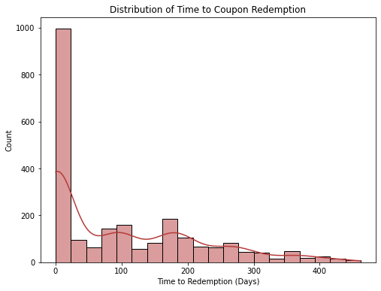
Analyzing Redemption Times Helps Grasps Customer Behavior
Coupon Optimization
Total Coupons Redeemed: 2318
Average Time to Redemption: 102 Days
Median Time to Redemption: 71 Days
Supply Chain Rangers LLC
11
Notes:
Nisha: Our aim is to attract new customers while maintaining profits despite discounts.
Analyzing redemption times helps us grasp customer behavior. Here’s how to turn these insights into action in under a minute.
1. Set Shorter Expiry Dates:
- Use shorter expiration dates to encourage quick redemption.
- This maintains urgency among customers.
2. Personalized Offers:
- Leverage customer data for tailored coupon deals.
- Targeting specific groups accelerates redemption.
3. A/B Testing:
- Test various coupon types and durations.
- Pinpoint the most effective strategies.
4. Boost Engagement:
- Heighten brand engagement for higher coupon usage.
- Employ social media, emails, and loyalty programs.
Knowing customer coupon redemption times is key. Customizing offers aligns with preferences and attracts customers, ensuring profitable growth. Let’s apply these insights to create compelling coupon promotions for lasting success.

Slide 12
Maximizing Discount Marketing to Increase Customer Acquisition
Coupon Optimization
Continue: 26, 30, 8
Terminate: 20, 6, 15
Supply Chain Rangers LLC
13
Notes:
Nisha: Understanding our customers is crucial for effective marketing and decision-making.
Let’s explore our top and bottom customer segments.
Starting with the top three:
1. “2 Adults, No Kids”; is our largest segment at 43.5%. It includes couples and career-driven individuals. Catering to their preferences can solidify our position.
2. “Adults, Kids”; make up 31.9% and are mainly families. Tailoring our offerings for them can tap into this valuable demographic.
3. “Single Females”; are 24.6%. Addressing their unique needs can help build strong relationships.
Moving to the bottom three:
1. “Single Males”; are 44.2%, a sizable group to target and diversify our customer base.
2. “Unknown”; at 34.0% requires research for better understanding.
3. “1 Adult, Kids”; represent 21.9%, offering growth opportunities with focused marketing.
Analyzing customer segments reveals opportunities and challenges. Focusing on top segments and meeting bottom segments&#39; needs can drive growth and customer satisfaction.

Slide 13
Coupon Optimization Recommendations
Coupon Optimization
Tailor Coupon Expiration Dates
Targeted Offers
A/B Testing
Customer Engagement
Supply Chain Optimization
Customer Segmentation
Supply Chain Rangers LLC
14
Notes:
Nisha: In our pursuit of attracting new customers and maintaining profitability, let’s explore actionable strategies from our analysis. Firstly, adjusting coupon expiration dates can make a big impact. Shorter periods prompt quicker redemption and urgency. Secondly, personalized offers shine. Using customer data, we craft targeted coupon promos that connect with specific groups, building loyalty. Thirdly, A/B testing is key. Trying diverse coupon types and durations uncovers high-response strategies. Next, we boost engagement. Social media, email, and loyalty programs amplify coupon use and satisfaction. Lastly, supply chain optimization is vital. Efficient inventory and vendor teamwork cut costs and improve delivery, enriching the customer experience. We’ll create compelling, timely coupon campaigns for lasting business growth by embracing these insights. Thank you. Let’s advance with these data-driven tactics.

Slide 14
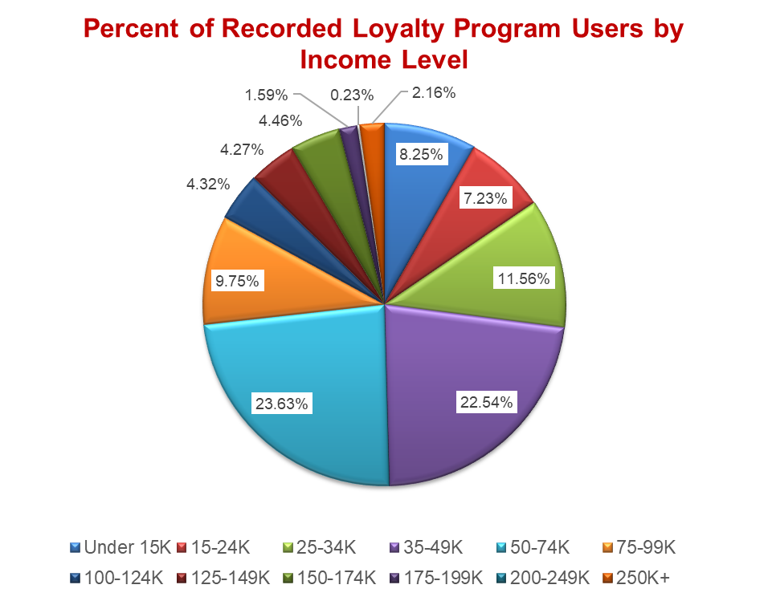
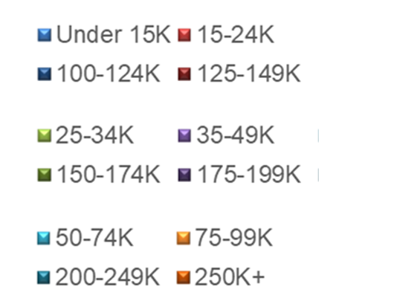
35-74K Income Bracket Drives Customer Loyalty Sales
Customer Loyalty Program
Supply Chain Rangers LLC
15
Notes:
The most prominent Customer Loyalty segments fall within the income ranges of 50-74k and 35-49k, respectively. Though this helps us understand segments that utilize this program most, it also helps us identify the opportunity area, which is the areas that are not in this income bracket. The income levels that do not fall within the 35-74k range are the areas we need to focus on from a strategy standpoint to grow sales.
Regression analysis demonstrates a statistically significant association between loyalty program membership and a notable increase in the average basket transaction, amounting to $31.35. Additionally, the intercept of $9.15 indicates a baseline value for basket transactions. This observed significance level of 99% underscores the robustness of the findings.

Slide 15
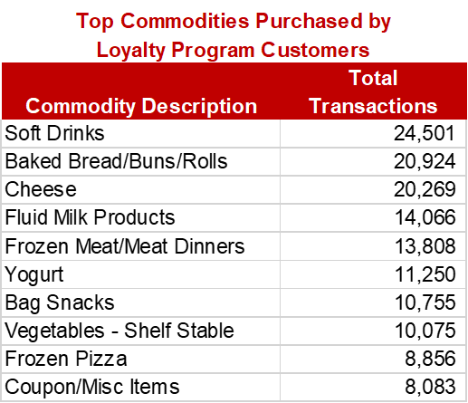
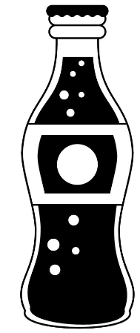
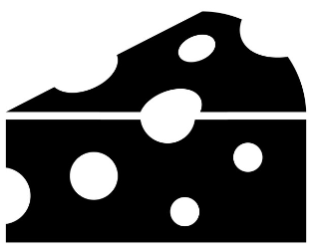

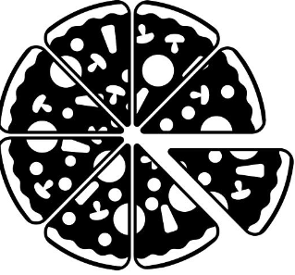
Loyalty Program Members Purchase a Mix of Utilitarian and Hedonic Goods
Customer Loyalty Program
Supply Chain Rangers LLC
16
Notes:
The investigation into customer purchase behavior reveals a distinct disparity between individuals who are loyalty program members and those who are not. Loyalty program customers exhibit a distinctive pattern in their buying preferences, encompassing a diverse assortment of utilitarian and hedonic goods. The data highlights soft drinks, breads, and cheese as the most frequently occurring items in their transactions, suggesting a penchant for both essential and indulgent products. This data is useful for determining commodity selections in an optimized model.
Given the pronounced influence of customer loyalty programs on sales and the prevalence of adoption among the aforementioned income segments, it is advisable for retailers to consider implementing such programs in their business strategies. By doing so, retailers can effectively leverage the potential of loyalty programs to maximize sales and foster stronger customer engagement within the targeted income bracket.

Slide 16
Product Portfolio Optimization Model Methodology
Product Optimization
Focus on the grocery department
Enhance product selection based on product family and product group
Filtered out seasonal items
Supply Chain Rangers LLC
17
Notes:
Daylyn: Grocery department is the highest performing department with the largest portion of products and having the highest sales value. Upon drilling into the grocery department layers, we found an opportunity to enhance product selection based on the product family and product group. In order to remain consistent with a holistic view across the segment of time we referenced previously and to take out seasonality of certain products, we decided to remove seasonal items to focus on products that would be sold year round that we could take consistent action on.

Slide 17
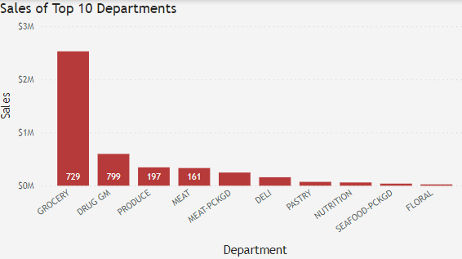
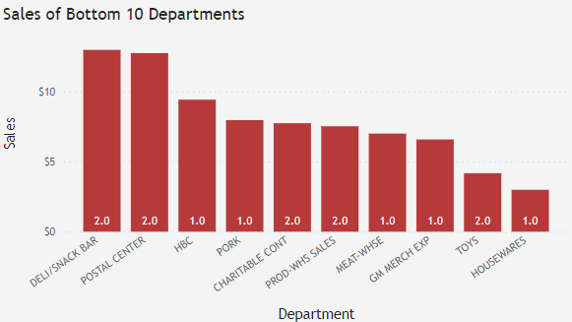
Grocery Top Sales Department and Accounts for Majority of Product Groups
Product Optimization
Grocery accounts for 44% of products as well as 31.8% of the product groups
Lower performing departments appear to be categories not related to grocery
Supply Chain Rangers LLC
18
Notes:
Daylyn: Looking at the department level performance, we found that our top 10 performing departments based on sales value have to do with those areas found in a traditional grocery market, with the grocery department having the highest performance out of the top 10 and account for 729 or 31.8% of the product groups. Looking at the lower performing departments, the categories appear to trend towards those not typically associated with grocery such as the postal center, housewares, and toys. This is why we are going through grocery to look at the process of optimizing products within this category.

Slide 18
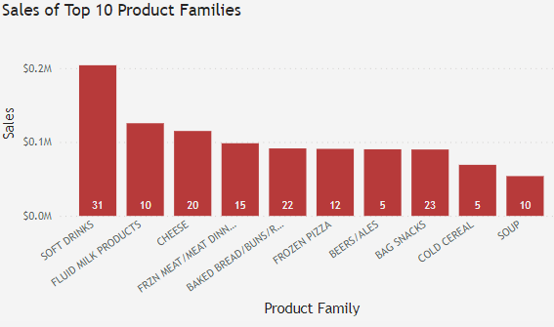
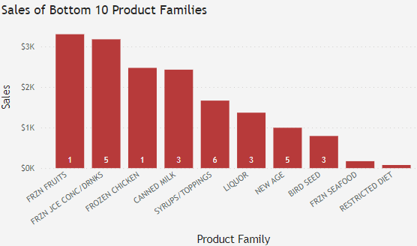
Soft Drinks Highest Performer of Product Family
Product Optimization
Soft drinks are the top performer of the grocery department
Frozen foods seem to make up the lower performing product families
Supply Chain Rangers LLC
19
Notes:
Daylyn: As we further drill down to the product family level, we see that our top sales segment in the grocery department is soft drinks. We also see that soft drinks has 31 product groups within this product family which contains 403 different product ids which can be due to different brands, flavors, and other differentiators in this category and this is what we see in the other family levels as well. In our bottom performing product families, we see that the product groups are much smaller indicating there is not a lot of these differentiators as well as a much lower performance in sales volumes. We are going to look at the soft drinks product family to delve deeper into our optimization process.

Slide 19
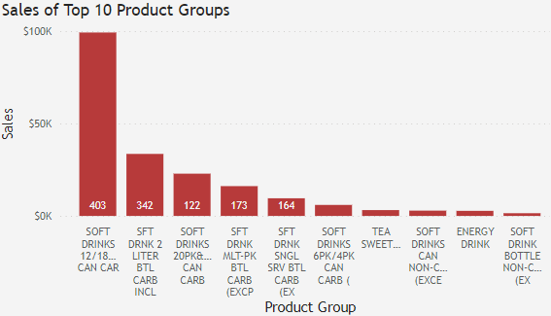
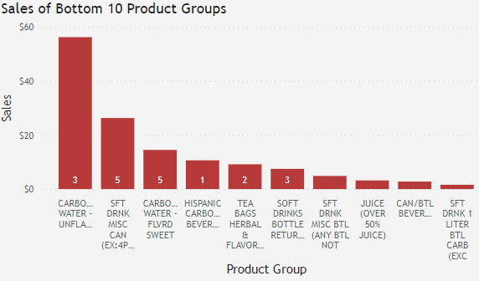
Identification of Low Performing Products Based on Throughput
Product Optimization
Lowest products past 2 Years
<10 Sales
Reiterate across product groups
Drill down to focus on the top performing segment of the Soft Drinks product group
Reiteration of drill down for each segment
Supply Chain Rangers LLC
20
Notes:
Daylyn: So focusing on the soft drinks product group over the past two years of transactional data that we have, 8% of these products have 10 or less quantity sold, which is really low compared to the higher end where the top product ids are selling around 3000-5000 over the past two years. Due to not having inventory data, we have to make product cuts based on the throughput levels. This will be reiterated through each product group under each product family so we can accurately eliminate products that are underperforming. If we look at the lower end of the product groups at soft drink 1 liter btl carbs excluded, this only has made 1 sale and has 1 product id over the last two years.

Slide 20
Product Portfolio Optimization Recommendations
Product Optimization
Inventory Data
Store Location Dats
Supply Chain Visibility Tools
Manufacturer Optimization and Diversification
Lowest Performing Products
Supply Chain Rangers LLC
21
Notes:
Daylyn: The first and probably most important is gaining more data on the inventory levels within each store. This will allow us to hone in on store performance and inventory levels so we can accurately predict and optimize product families and groups based on inventory data. This will show us what is being held for long periods of time as well as what is selling out fast. Items that sit too long could be put up for proposal for elimination and then that space taken over with more supply of products that continuously sell out due to demand. Store location will also help us determine what items are popular in what areas so we can enhance our supply chain routes and pick up on trends that occur in individual stores so supply can be modified accordingly. Adding this additional information will allow us to start implementing and enhancing supply chain visibility tools such as our demand forecasting model, manufacturer efficiency, overall supply chain visibility, as well as the performance measurements of the products. The stores we observed have over 6,287 different manufacturers. While it is important to have a diverse set of manufacturers to limit supply chain bottlenecks and shortages, it is also important to be able to have a manageable supply chain. Cutting products will create a less complex manufacturer network and hopefully create a more streamlined supply and production process, be able to create stronger relationships with our manufacturers and improve supply chain transparency through data sharing across these networks.

Slide 21
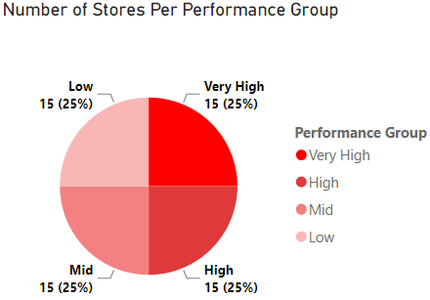
Performance Based Store Segmentation
Store Segmentation
Segments
Low Performance: 15 stores | 0 - 25th percentile
Mid Performance: 15 stores | 25th - 50th percentile
High Performance: 15 stores | 50th - 75th percentile
Very High Performance: 15 stores | 75th - 100th percentile
Supply Chain Rangers LLC
22
Notes:
San
Okay, so let’s get started with performance based store segmentation
This segmentation is based on 2 periods of 60 stores total sales
They were broken down using the percentile function in python (What does this mean?)
As you can see we have 4 groups of store performance Low, Mid, High, and Very High
There are 15 stores in each segment given their total sales percentile ranking
Let’s dive a little deeper into the sales

Slide 22
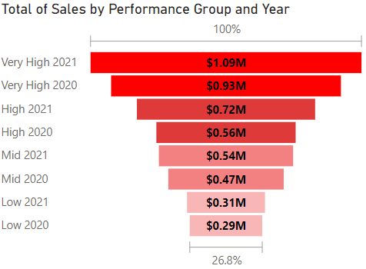
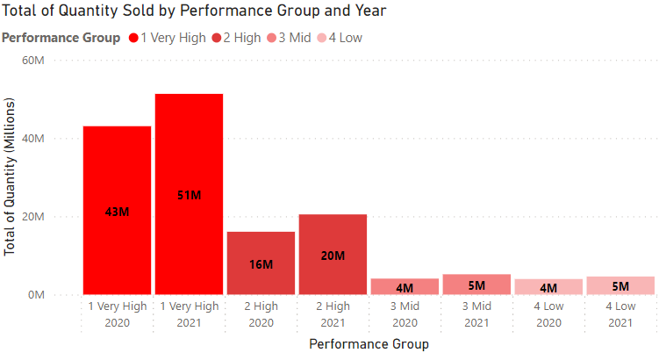
Very High Segment Shows Best Sales Performance
Store Segmentation
Total Qty
2020: 67.1M
2021: 81.6M
Total Sales
2020: $2.24M
2021: $2.66M
Total Segments Sales for 2020 - 2021
Total sales increased annually for each segment
Total Segments Quantities for 2020 - 2021
Total quantity sold increased annually for each segment
Supply Chain Rangers LLC
23
Notes:
San: Now over here we have the
Total Segments Sales for 2020 - 2021
Total sales increased annually for each segment
From $2.24M in 2020 to $2.66M in 2021
The segments sales show an ordinal pattern
Very High segment is the best sales performer
Very High sales is 1.5X more than the High segment
High sales is 1.3X more than the mid and Low segments
Are these stores actually performing well?
Right Side
Let’s look at how the quantity analysis reshapes our performance perspective
Total quantity sold increased annually for each segment
Semi-ordinal quantity (qty) pattern
Very High qty is 2.5X more than the High segment
High qty is 4-5X more qty than the mid and Low segments
Wholesale? Is this efficient? This led to further investigations of the relation between sales and quantity sold

Slide 23
Mid Segment is Most Sales Efficient and Profitable
Store Segmentation
2020 - 2021 Sales and Quantity Growth Rate by Segment
Segment | Quantity Growth % | Sales Growth %
Very High | 15.68% | 22.23%
High | 20.00% | 22.23%
Mid | 20.00% | 12.50%
Low | 20.00% | 6.45%
Annual Sales Return to Quantity Ratio by Segment
Segment | 2020 |  |  | 2021
 | Qty (Millions) | Sales (Millions) | Return Ratio | Qty (Millions) | Sales (Millions) | Return Ratio
Very High | 43M | $0.93M | $0.02 | 51M | $1.09M | $0.02
High | 16M | $0.56M | $0.03 | 20M | $0.72M | $0.03
Mid | 4M | $0.47M | $0.11 | 5M | $0.54M | $0.10
Low | 4M | $0.29M | $0.07 | 5M | $0.31M | $0.06
Best Performance: Least additional quantity sold for the highest additional earned sales
Sales Efficiency: Highest value returned on each unit sold resulting on larger margin (profit)
Supply Chain Rangers LLC
24
Notes:
San
Therefore, we drove our focus to the sales efficiency
Growth
The Very High segment indicates the best growth performance
Is it efficient?
Right Side
When the sales are compared to quantity sold, it appears that the Very High segment is the least efficient or even profitable segment due to sales inefficiency
(Had lowest value returned on each unit sold $0.02).
Efficiency: Sales Return on each item sold
Mid segment is the most efficient segment returned $0.10 for each unit sold
Very High & High segments are the least profitable (2-3 cents)
High logistical costs Okay, how can we use this information to empower our client strategy to generate more profit more efficiently?

Slide 24
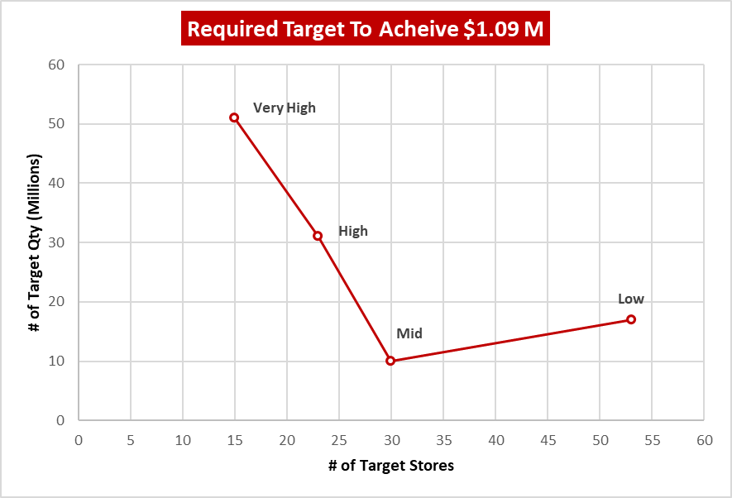
Mid Segment Simulation Returns
Store Segmentation
Very High
$1.09M
MID
$0.10
MID
30
MID
10M
Target Return Ratio
Target Sales
Target
Stores
Target
Qty
2021 Segments Simulation
Segment | Original Sales/ Segment | Original Qty/ Segment | New Target Stores | Additional Stores Required | New Target Qty | New Sales Return Ratio
Very High | $1.09M | 51M | 15 | 0 | 51M | $0.02
High | $0.72M | 20M | 23 | 8 | 31M | $0.03
Mid | $0.54M | 5M | 30 | 15 | 10M | $0.10
Low | $0.31M | 5M | 53 | 38 | 17M | $0.06
Supply Chain Rangers LLC
25
Notes:
San We decided to run a simulation to identify which store can generate these targets.
The highest sales of $1.09M
The highest return ratio of $0.10
Given the 2021 data, this simulation table represents how many stores would be needed to achieve the best target sales return ratio
Right Side
The simulation result shows that the MID segment can achieve the highest $1.09M sales and $0.10 return ratio with 15 additional stores by selling 10M units in total, unlike the very high segment 15 stores selling 51M in total with the lowest return ratio $0.02.

Slide 25
Segment Analysis Recommendations
Store Segmentation
Sales alone is a deceiving metric
Mid segment is the best performing segment
What’s next?
Evaluate opportunity cost of lowest performing Very High and High segment stores
Trade for Mid stores
Identify segments stores combination equilibrium point
Supply Chain Rangers LLC
26
Notes:
San
“Getting bigger doesn’t necessarily mean getting better” “The mid portfolio is better than the bigger portfolios
Using quantity sold uncovered hidden facts about the deceiving sales perspective
The high and very high stores are burning money on logistics given the number items they had to sell
What can be done more precisely?
Find the lowest performing stores in high and very high segment
Trade these stores for Mid Stores
Evaluate the stores combination in each segment to identify the equilibrium point using the Total fixed and variable costs (Which was not a part of the data Dunnhumby provided us)

Slide 26
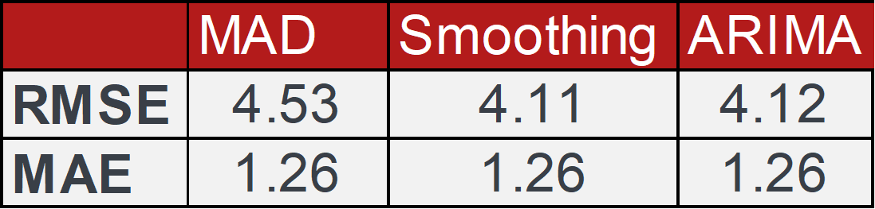
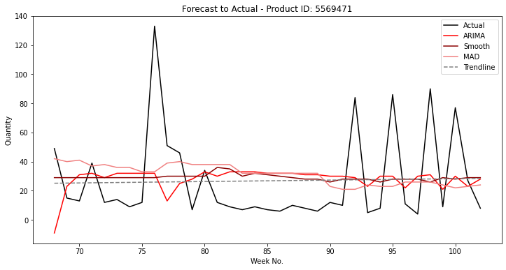
Exponential Smoothing is the Most Accurate Method
Demand Forecasting
Supply Chain Rangers LLC
28
Notes:
Slide 28: Exponential Smoothing is the Most Accurate Method
We evaluated 3 forecasting methods moving average demand, exponential smoothing and autoregressive integrated moving average (ARIMA).
We ran trained the models using the initial 68 weeks of data and optimized the parameters for each store and product as determined by the lowest Root Mean Square Error (RMSE).
We then used the models to predict the remaining weeks of the data and graded the overall accuracy of the optimized models and found that exponential smoothing produced the lowest error of the three but they were very close.
The exponential smoothing method offers a good balance between prediction accuracy and computational complexity, and can be easier to use than ARIMA for many applications.
All three models do very well at identifying general trends but have difficulty predicting the spikes and dips.

Slide 27
Demand Forecasting Recommendations
Demand Forecasting
Additional Product Data
External Factors
Machine Learning Techniques
Enhanced Data Preprocessing
Coupon/Marketing Data
Regular Model Evaluation and Updates
Supply Chain Rangers LLC
29
Notes:
Slide 29: Demand Forecasting Recommendations
The demand forecast could be improved with more data and model aggregation.
By including data regarding upcoming coupon campaigns you can better account for the demand generated by those marketing efforts.
Including further product data like current or anticipated pricing and brand will provide specific data points that ML techniques could you to identity similar products to generate better data comparisons
Data regarding external factors such as economic conditions and industry trends can better inform the models to account for non product specific trends.
The output from models like MAD, ARIMA, and Exponential Smoothing can be used as features in more advanced, machine learning-based forecasting models. By combining these features with additional information, such as coupon data, we could create a hybrid model that captures both general trend patterns and the nuanced effects of promotions.
More advanced methods like ensemble learning, deep learning, or reinforcement learning can be utilized to improve forecasting accuracy. These methods can effectively capture complex patterns and non-linear relationships in the data, offering more precise forecasts.
Improving the way the data is cleaned, transformed, and input into the forecasting models can lead to more accurate predictions. This could include handling outliers, missing values, and skewed distributions, as well as using techniques like feature scaling and encoding.
The demand forecasting models should be regularly evaluated and updated based on their performance. By systematically assessing their accuracy using measures like RMSE and MAE, we can identify weaknesses and make necessary adjustments to enhance forecast precision.

Slide 28
Up Next
Meet the Team
Executive Summary
Data Overview
Supply Chain Optimization
Coupon Optimization & Customer Loyalty Program
Store Optimization Model & Store Segmentation
Demand Forecasting
Closing Statement and Recommendation
Supply Chain Rangers LLC
30
Notes:
Daylyn

Slide 29
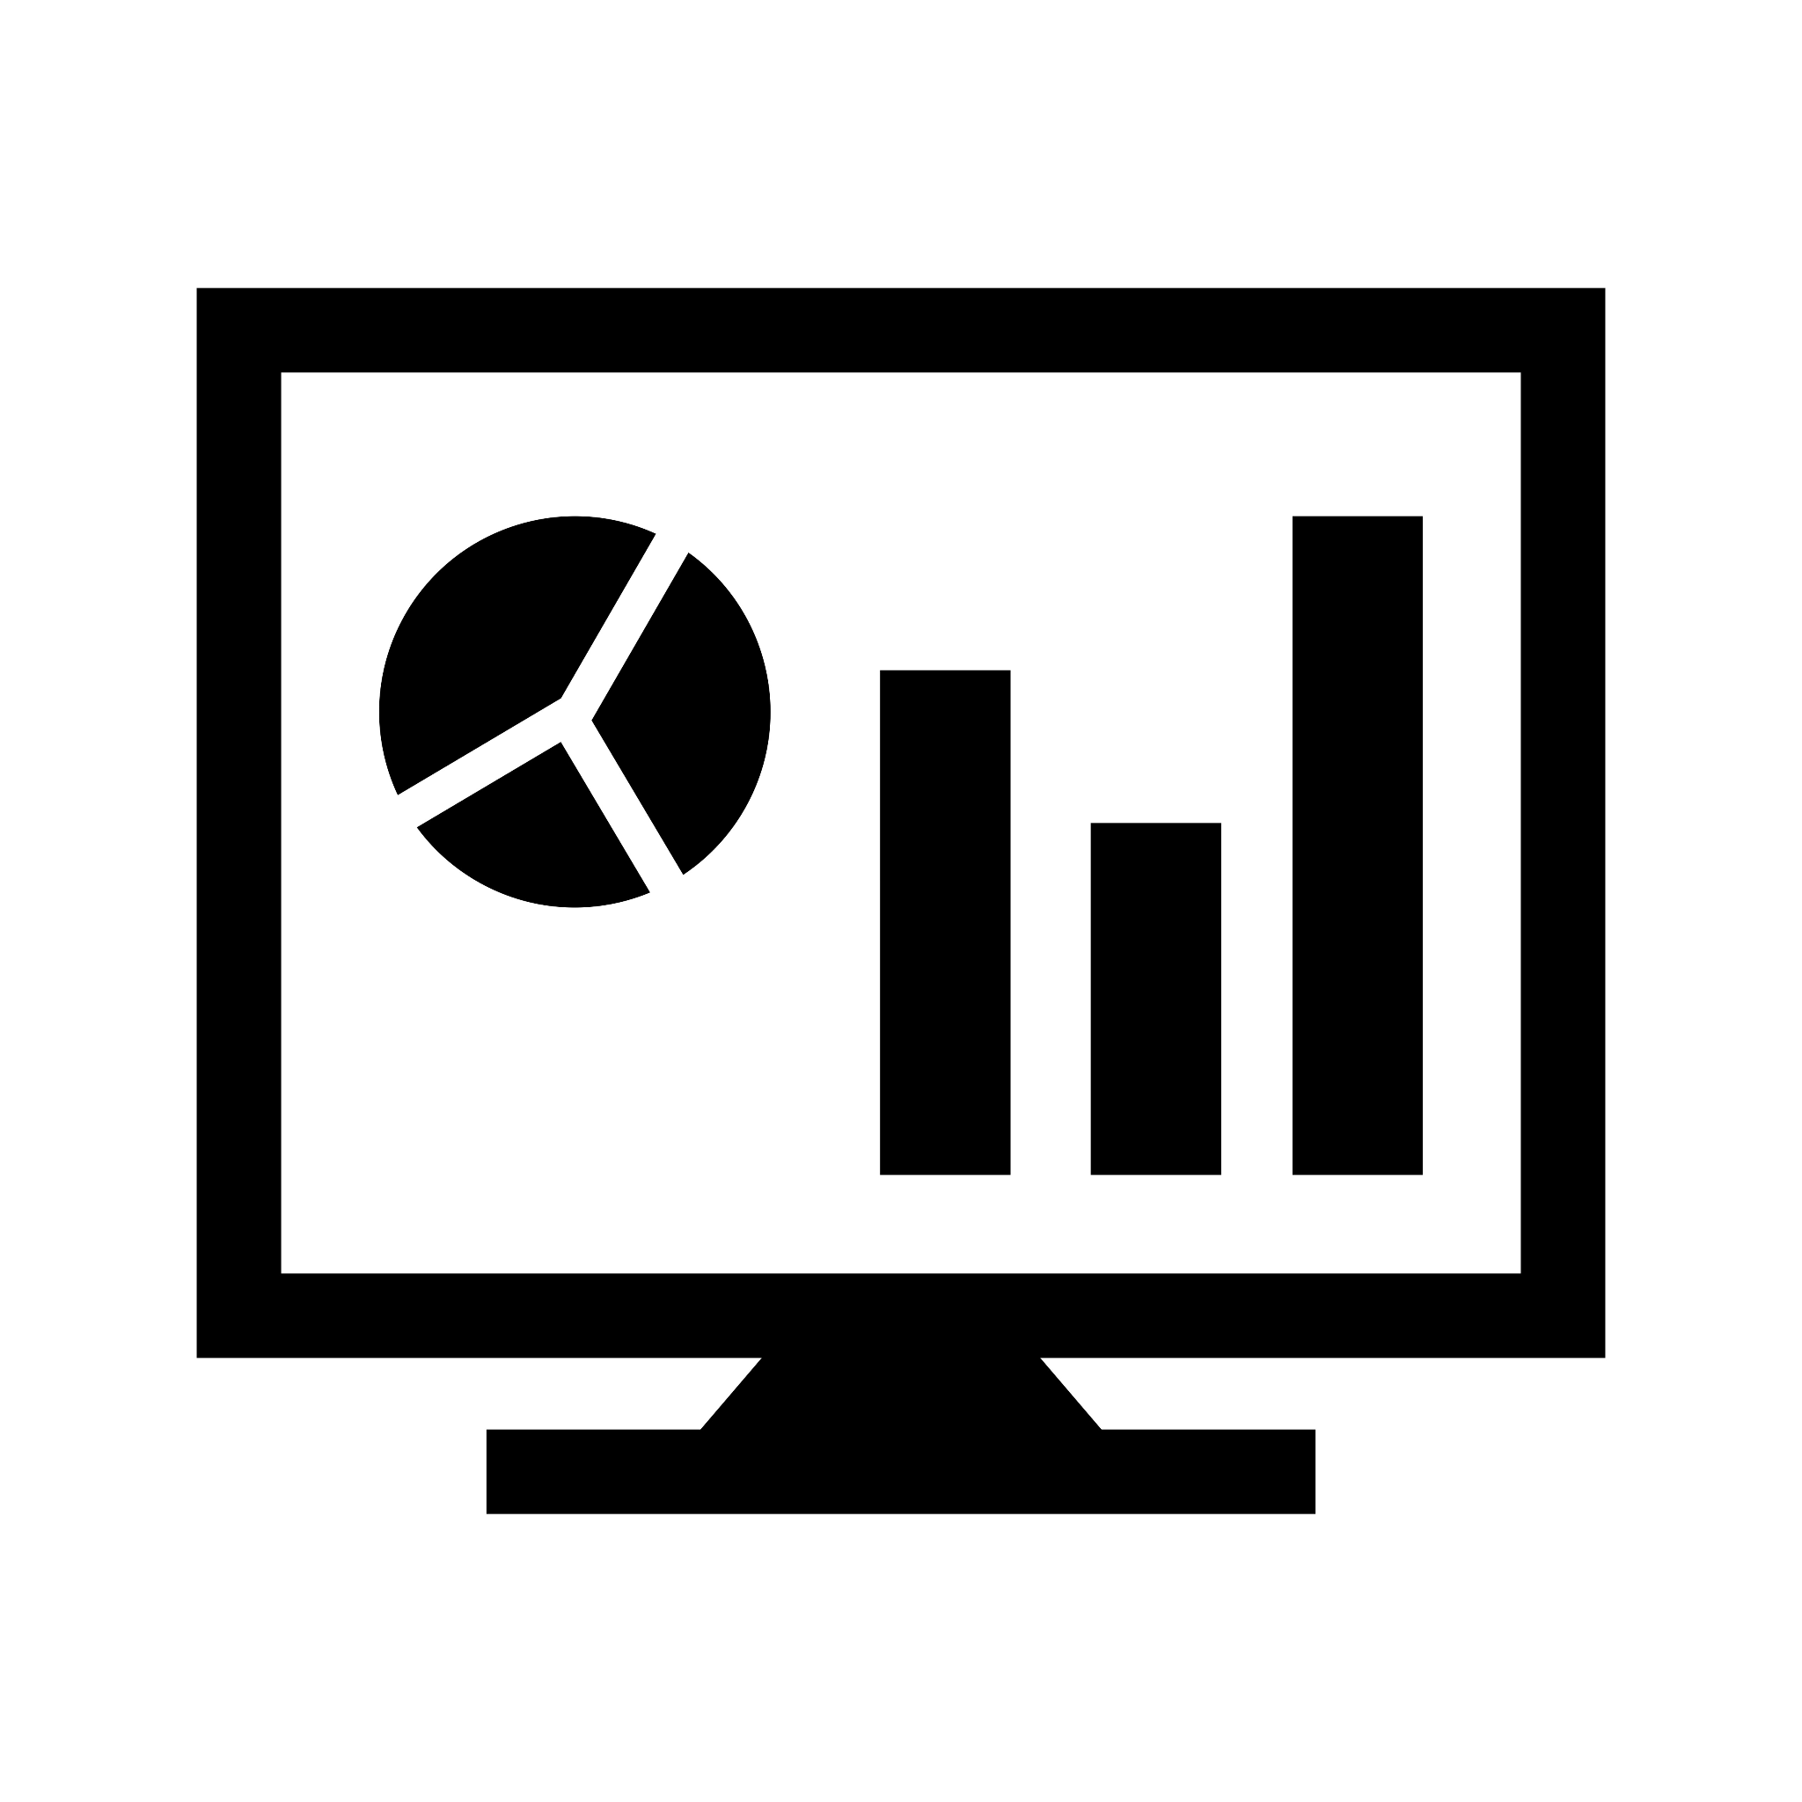


Implement These Strategies Today to Increase Profits Tomorrow
Closing Statements and Recommendations
Implement an exponential smoothing model to improve demand forecasting.
Increase the number of stores that follow the model of Mid segment.
Optimize product offerings and eliminate underperforming products.
Tailor promotional strategies for the 50-74k income group.
Focus on the customer loyalty program for income levels of 35k to 74k.
Supply Chain Rangers LLC
31
Notes:
Addressing the immediate opportunities, these actions represent the low hanging fruit that can be harnessed today for a notable impact on tomorrow. Initiating an exponential smoothing model stands to refine demand forecasting with swift effect. Expanding the adoption of the Mid segment store model promises heightened success. Through meticulous product optimization and the pruning of underperforming items, efficiency gains can be readily realized. To tailor promotional approaches for the 50-74k income bracket is a strategic move that can yield prompt results. Lastly, channeling efforts into strengthening the customer loyalty program for individuals earning between 35k to 74k demonstrates a focused commitment to fostering lasting customer relationships.

Slide 30


Expand Your Data for Medium to Long Term Gains
Closing Statements and Recommendations
Expanding on the data captures to include location and inventory information allows for expanded insights and further optimization of the model through:
Localized Demand Analysis
Optimized Inventory Management
Dynamic Pricing Strategies
Further Segmentation Analysis
Regional Trend Analysis
Competitor Analysis by Region
Customer Segmentation by Location
Geotargeted Marketing Campaigns
Supply Chain Rangers LLC
32
Notes:
Here are the recommendations for medium to long term gains:
Localized Demand Analysis: By incorporating location data (such as geospatial information or ZIP codes), the model can identify regional variations in demand for products and services. This can help with geotargeted marketing, customer segmentation by location, and competitor analysis by region.
-Optimized Inventory Management: With inventory data integrated into the model, businesses can better predict demand patterns and optimize their inventory levels accordingly.
-Location Based Data:
-Dynamic Pricing Strategies: Combining sales, transaction, and inventory data with location information allows the model to develop dynamic pricing strategies.
-Seasonal and Regional Trends Analysis: The model can identify seasonal and regional trends by analyzing historical data from various locations.
Segmentation: In pursuit of optimizing performance and maximizing potential, we conduct a rigorous analysis of opportunity costs for our lowest performing Very High and High segment stores. By trading for Mid stores, we aim to strike the ideal balance and identify the equilibrium point for a winning combination of store segments.

Slide 31


Thank you!
Questions?
Supply Chain Rangers LLC
33

Slide 32
Appendix
Supply Chain Rangers LLC
35

Slide 33
Data Analysis and Selection
Data Overview
The original data had 582 stores, 6476 manufacturers, and over 92,000 products
The time period of the data spanned at max a total of 102 weeks
Many of the stores had little or incomplete data
Due to this we filtered the data to include only stores that had the most complete data over the recorded time period
Supply Chain Rangers LLC
36
Notes:
Justin Initial Data Overview:
The initial dataset comprised 55 million product transaction records from 582 different stores.
Data Analysis:
An in-depth analysis revealed a significant number of stores with incomplete transaction records over the dataset's timeline. In fact, several stores only had one transaction during the entire 102-week period.
Data Filtering:
To ensure a consistent timeline, transaction data was filtered to include only those stores with a record spanning the full dataset period. The selection criteria were stores with a minimum week of data at 1 and a maximum week of data at 102.
Incomplete Weeks:
It's important to note that not all selected stores had data for every single week within the 102-week range. Some stores had data for as few as 100 weeks.
Assumptions and Potential Bias:
Despite the potential for bias introduced by this filtering approach, it was deemed appropriate for the project's purpose: building a model for product optimization. This is based on the assumption that a consistent timeline across all stores is more important for accurate demand forecasting and subsequent product mix optimization. Then we can test the model on other stores and adjust it as needed to correct for the bias.

Slide 34
Top 3 Customers in Each Demographic Segment
Appendix
AGE
45-54 35.95%
35-44 24.21%
25-34 17.7278%
INCOME
50-74K 23.97%
5-49K 21.47%
75-99K 11.98%
HOMEOWNER
HOMEOWNER 62.92%
UNKNOWN 29.08%
RENTER 0.05%
MARITAL STATUS
Unknown 0.43%
Single 0.42%
Married 0.15%
HOUSEHOLD SIZE
2 0.40%
1 0.32%
3 0.14%
KIDS
NONE/UNKNOWN 0.70%
1 0.14%
3+ 0.09%
Supply Chain Rangers LLC
37
Notes:
Nisha: This slide provides an analysis of the top and bottom customer types based on various demographic categories. The data showcases the percentage distribution of different customer types within each category. Understanding these patterns can help in making informed business decisions and targeting specific customer segments effectively.
1. Top and Bottom Customer Types - Age Description:
- Age groups 45-54 and 35-44 represent the top customer types, accounting for 35.96% and 24.22%, respectively.
- Younger age groups 25-34 and 65+ represent 17.73% and 8.99% of customers, respectively.
- Age groups 55-64 and 19-24 are the bottom customer types, accounting for 7.37% and 5.74%, respectively.
2. Top and Bottom Customer Types - Marital Status Code:
- Customer type 'U' (unknown) and 'A' (single) are the top customer types, each representing 42.95% and 42.45%, respectively.
- Customer type 'B' (married) accounts for 14.61% of customers, making it one of the bottom customer types.
3. Top and Bottom Customer Types - Income Description:
- Customers with income levels between 50-74K and 35-49K are the top customer types, representing 23.97% and 21.47%, respectively.
- High-income categories such as 75-99K, 175-199K, and 200-249K each account for 11.98%, 1.37%, and 0.62% of customers, respectively.
- The ultra-high-income group, 250K+, and income level 200-249K, are the bottom customer types, each accounting for only 0.14% of customers.
4. Top and Bottom Customer Types - Homeowner Description:
- Homeowners constitute the top customer type, representing 62.92% of customers.
- Customers with unknown homeowner status are also significant, making up 29.09% of the customer base.
- Renters, including probable renters, constitute the bottom customer types, representing only 5.24% of customers.
5. Top and Bottom Customer Types - Household Size Description:
- Households with 2 members are the top customer type, accounting for 39.70% of customers.
- Households with 1 member are also significant, representing 31.84% of the customer base.
- Larger households with 3 or more members are the bottom customer types, each accounting for approximately 13.61% of customers.
6. Top and Bottom Customer Types - Kid Category Description:
- Customers with no kids or unknown kid status are the top customer types, representing 69.66% of the customer base.
- Customers with 1 kid or 3+ kids constitute the bottom customer types, each accounting for around 14.23% and 8.61% of customers, respectively.
Analyzing the top and bottom customer types across various demographic categories provides valuable insights for targeted marketing and customer engagement strategies. Understanding customer preferences and demographics allows businesses to tailor their products and services to specific customer segments effectively.

Slide 35
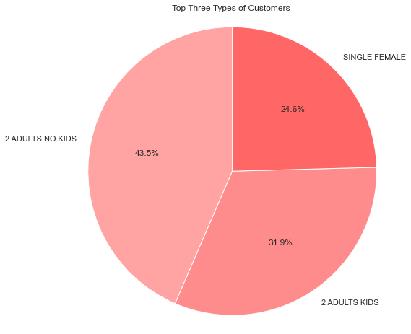
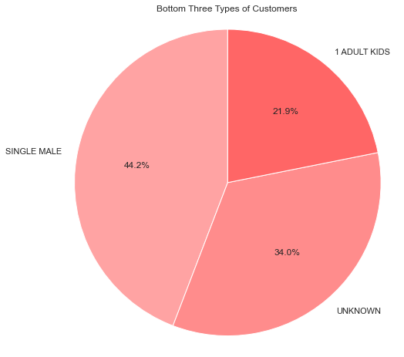
Top Performing Customer Demographics
Closing Statements and Recommendations
TOP 2 Adults, No Kids 43.5%
BOTTOM Single Male 44.2%
Supply Chain Rangers LLC
38
Notes:
Nisha: In this slide, we present a concise analysis of our customer segmentation. Understanding the distribution of customers across various demographic segments is crucial for shaping effective marketing strategies and making informed business decisions.
Let's begin by examining the top three customer segments:
-The largest segment, accounting for 43.5% of our customer base, is "2 Adults, No Kids." This group may include young couples, empty-nesters, or career-focused individuals. By catering to their specific preferences, we can solidify our position in this significant market segment.
-Next, we have "Adults, Kids," representing 31.9% of our overall customer base. This segment consists mainly of families with children, presenting a valuable opportunity to tailor our offerings to meet the needs of this demographic.
-Lastly, the "Single Female" segment makes up 24.6% of our customers. By understanding and addressing their unique requirements, we can build strong relationships and enhance loyalty among single female customers.
Now, let's shift our focus to the bottom three customer segments:
-The largest segment among the bottom three is "Single Male," comprising 44.2% of our customers. Targeting this segment effectively can help us diversify our customer base and expand our market share.
-The "Unknown" segment represents 34.0% of our customers and lacks clear demographic data. To tap into the potential of this group, further research is essential to better understand their preferences and needs.
-Lastly, "1 Adult, Kids" constitutes 21.9% of our customer base. By devising targeted marketing strategies for this segment, we can capitalize on the opportunities within this market.
In conclusion, analyzing customer segmentation allows us to identify key opportunities and challenges in our market. By focusing on the top segments and addressing the needs of the bottom segments, we can drive growth and enhance customer satisfaction.

Slide 36
Coupon Optimization Further Analysis
Appendix
CLV
Predicts net profit attributed to the entire future relationship with a customer.
Accurate CLV calculation requires extensive data on repeat purchase behavior, customer retention rate, and associated costs over an extended period.
Without this data, determining the long-term impact of coupon usage on profitability is challenging.
Cannibalization Rate
Cannibalization refers to the extent to which discounted sales replace full-price sales.
High cannibalization could erode potential profit gains from a coupon campaign.
Calculating cannibalization accurately necessitates data on customer purchase intent and behavior, which may not be accessible at the moment.
Supply Chain Rangers LLC
39
Notes:
Nisha:

Slide 37
Tracking Acquisition and Usage Can Improve Engagement and Loyalty
Coupon Optimization
% of Repeat Coupon Usage:
% of New Customers Acquired:
0.15%
19%
Supply Chain Rangers LLC
12
Notes:
Nisha: In assessing coupon effectiveness, two key metrics stand out:
Firstly, Repeat Coupon Usage: This metric gauges customer loyalty and coupon engagement. The slide presents data on customers who are repeat coupon users versus those who aren’t. High repeat coupon usage signals effective customer retention. However, we propose refining this metric to align with our coupon optimization goal. Instead of raw customer counts, we suggest calculating repeat coupon usage as a percentage of total transactions. This approach reveals how frequently customers utilize coupons in their transactions and identifies opportunities to reduce coupon use while still attracting customers. Currently, Repeat Coupon Usage is at 0.15%.
Secondly, New Customer Acquisition Percentage: This metric measures how well the coupon campaign expands our customer base. The slide displays the percentage of new customers gained through the campaign. With an acquisition rate of 18.99%, the campaign has succeeded in attracting fresh customers.

Slide 38

Customer Loyalty Program
Appendix
Key Takeaways
Customer loyalty programs have a substantial impact on sales, enhancing overall volume per basket.
Two distinct income levels (35k to 74k) exhibit almost double the loyalty program usage compared to others.
Retailers should consider implementing loyalty programs to maximize sales and customer engagement.
Strategically stock and prioritize goods and services in demand among the targeted income range.
This tailored approach aligns with consumer preferences, optimizing program efficacy and boosting sales.
Supply Chain Rangers LLC
40
Notes:
Ben
The empirical analysis indicates that customer loyalty programs exert a substantial impact as sales drivers, notably enhancing the overall sales volume per basket. Additionally, a noteworthy observation emerges from the income distribution, revealing two distinct income levels that exhibit nearly double the usage of loyalty programs compared to the next closest level. Specifically, these levels correspond to individuals earning annual incomes ranging between 35k and 74k, signifying a concentrated adoption of customer loyalty programs within this income bracket.
Given the pronounced influence of customer loyalty programs on sales and the prevalence of adoption among the aforementioned income segments, it is advisable for retailers to consider implementing such programs in their business strategies. By doing so, retailers can effectively leverage the potential of loyalty programs to maximize sales and foster stronger customer engagement within the targeted income bracket. Furthermore, in order to capitalize on this opportunity, retailers should strategically stock and prioritize the categories of goods and services that are in high demand among customers falling within the identified income range. This tailored approach aligns with consumer preferences, thereby optimizing the program's efficacy and further bolstering sales performance.

Slide 39
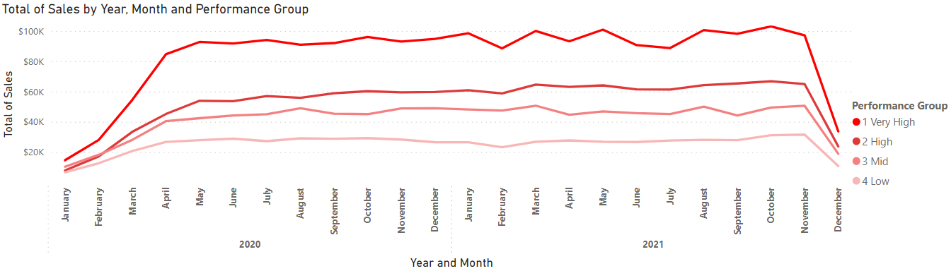
Segment Sales Performance
Appendix
This line chart demonstrates the sales performance of store segments from year 2020 to 2021
The total of sales increased for each segment between 2020 to 2021
No additional trends were identified
Supply Chain Rangers LLC
41
Notes:
San

Slide 40
Segment Simulation Calculations
Appendix
Very High $1.09M
Mid
$0.10
Target Sales
Target Return Ratio
2021 Segments Simulation
Segment | Sales/ Segment | Sales/ Store | Qty/ Segment | Qty/ Store | Target Stores | Additional Stores Required | Target Qty | New Sales Return Ratio
Very High | $1.09M | $73K | 51M | 3.4M | 15 | 0 | 51M | $0.02
High | $0.72M | $48K | 20M | 1.33M | 23 | 8 | 31M | $0.03
Mid | $0.54M | $36K | 5M | 0.33M | 30 | 15 | 10M | $0.10
Low | $0.31M | $21K | 5M | 0.33M | 53 | 38 | 17M | $0.06
Supply Chain Rangers LLC
42
Notes:
San

Slide 41
Segment Analysis Recommendations
Closing Statements and Recommendations
Sales alone is a deceiving metric
Very High segment 2.5x qty / High segment
$0.02 per item sold
High segment sell 4-5x qty / Low and Mid segments
$0.03 per item sold
Profit burning due to higher logistical expenses
Mid segment is the best performing segment
Mid segment to sell 4x less qty to achieve $1.09M
$0.10 per item sold
30 Mid stores selling 10M units = $1.09M - 4x less logistical costs = higher profit margin
15 Very High stores selling 51M units = $1.09M - 4x more logistical costs = lower profit margin
What’s next?
Evaluate opportunity cost of lowest performing Very High and High segment stores
Trade for Mid stores
Identify segments stores combination equilibrium point
Conduct A/B testing to examine fuel stations impact sales on Mid and Low segments
Supply Chain Rangers LLC
43
Notes:
San

Slide 42
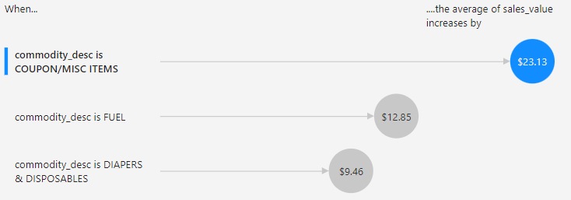
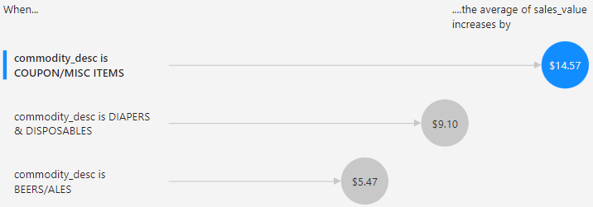
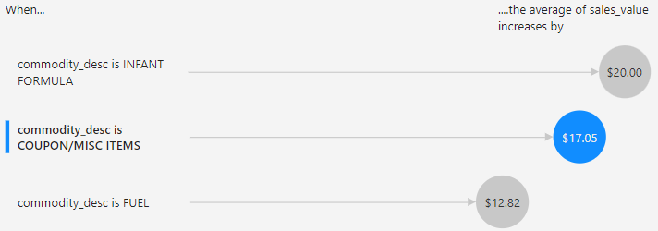
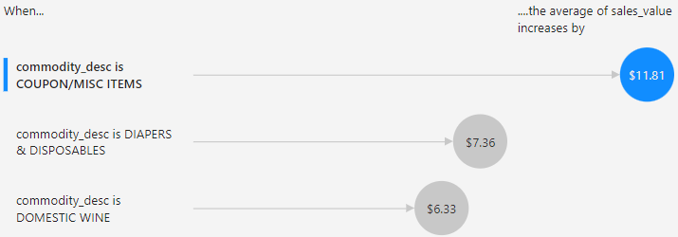
Segment Sales/Product Regression
Store Segmentation
Very High Segment
Mid Segment
High Segment
Low Segment
Supply Chain Rangers LLC
44
Notes:
San The coupons and the infant commodities appear to be highly attractive to customers in all segments, however one remarkable insight is that the Very high and High segments sell fuel, while the Low and Mid segments do not.
That leaves the Low and Mid segments missing out on additional growth and profit opportunities.

Slide 43
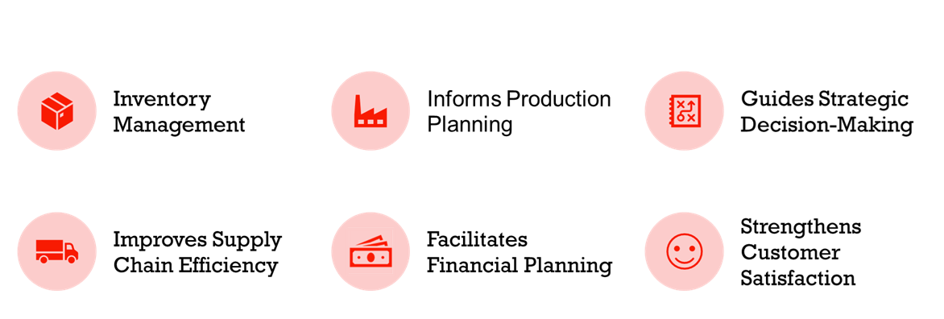
Demand Forecasting Drives Operational and Strategic Performance
Demand Forecasting
Supply Chain Rangers LLC
27
Notes:
Slide 27: Demand Forecasting Drives Operational and Strategic Performance
Demand forecasting plays a crucial role in an organizations sales and operations planning by doing the following things.
Enhances Inventory Management: By predicting future product demand, businesses can better manage their inventory levels, reducing storage costs and mitigating risks of stock-outs or overstocking.
Informs Production Planning: Accurate demand forecasts allow companies to plan their production schedule effectively, optimizing the product mix to align with consumer demand and market trends.
Guides Strategic Decision-Making: Demand forecasting provides essential data for making strategic decisions about product mix, such as discontinuing underperforming products, promoting popular ones, or introducing new products.
Improves Supply Chain Efficiency: With reliable demand forecasts, businesses can synchronize their supply chain operations with expected demand, enhancing the efficiency and effectiveness of procurement, production, and distribution processes.
Facilitates Financial Planning: Predicting product demand helps businesses forecast sales revenue, plan budgets, and make investment decisions, contributing to overall financial stability.
Strengthens Customer Satisfaction: By ensuring the right products are available at the right time, demand forecasting supports businesses in meeting customer expectations, enhancing satisfaction and loyalty.

Slide 44
Model Performance Over Time
Demand Forecasting
Supply Chain Rangers LLC
45
Notes:
Justin: The models we generated at great at “leveling” demand while considering long term trends but it struggles with capturing spikes which may be cyclical. Though any of these models may provide are definitely a step forward it can be improved with more data not provided to us in the dataset.

